Slide 1


Team Work Assignment
Notes:
.

Slide 2


Single Player game
Fastest is the best
Discover all empty squares
Avoid all mines
Notes:
Find the empty squares while avoiding the Mines. The faster you clear the board , the better you score !

Slide 3
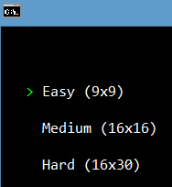
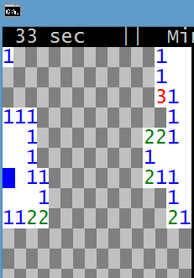
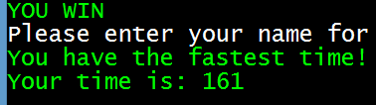
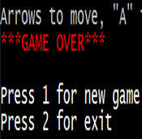
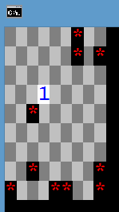
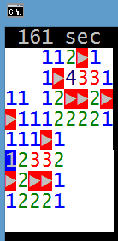
MINESWEEPR GAMEPLAY
Dificalty
Emptyfileds
WINGAME
GAME OVER

Slide 4

LIVE DEMO
PLAY ME

Slide 5

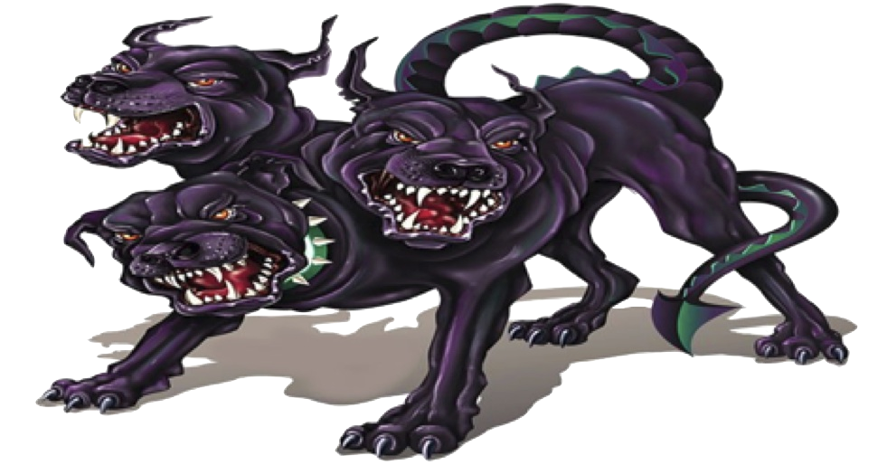
TEAM
Velimira Madjarova
Pavleta Taseva
Decho Dechev
Mihail Yankov
Kiril Borisov
Ivan Kitanovski
Niko Tsonev
Dobromir Ganev

Slide 6

QUESTTION

